Slide 1
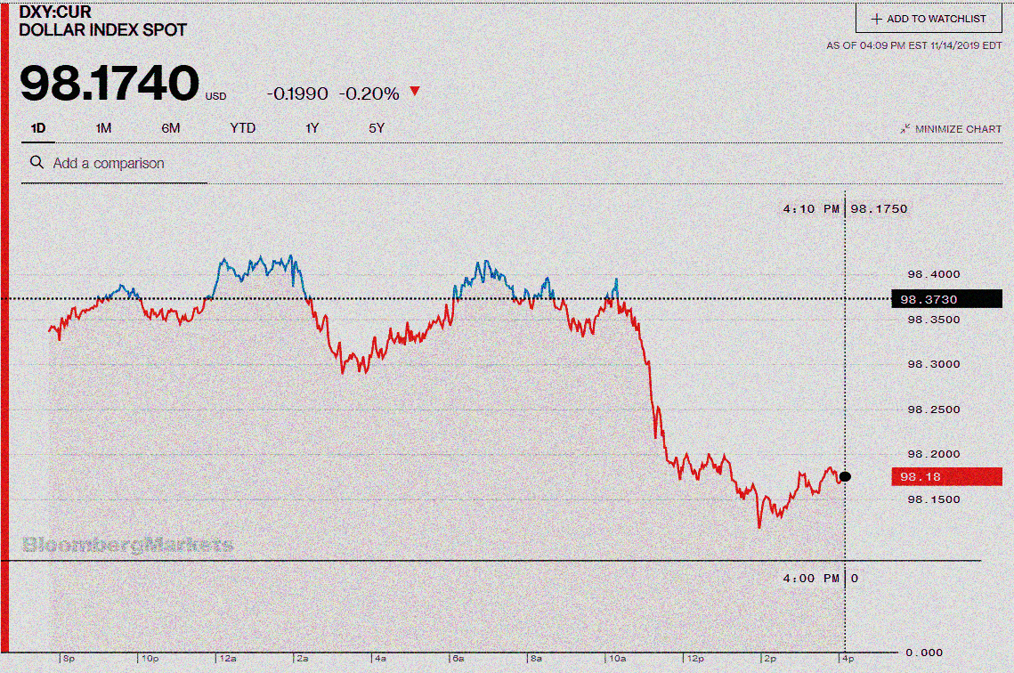
Investment Advisor

Slide 2

Group Members
Nikhil Mogre
Jayesh Patil
Sumit Singh Rajpoot
Chitra Pandey

Slide 3
OBJECTIVE
Objective 1: To update the data in Google Sheets using Python.
Objective 2: To suggest a KPI that can be used to pick stocks from different sectors.

Slide 4
Tools Used
Python
Gspread
Google API
Pandas
Excel

Slide 5
Datasets Used
Sheet 1: This data contains the data of 500 stocks listed in Indian stock exchange as on 5 September 2022.
Link: https://docs.google.com/spreadsheets/d/1Vshnw2giPF-mdCeBpjinR6JQJ4dvSS_m2w0MoFotnI0/edit#gid=2073305482
Sheet 2: This data contains the income and expense details of an individual
Link: https://docs.google.com/spreadsheets/d/1RT0TedaaMEyEWREsoZAbDVKg8xOYmlpf1nqZdob9Hwg/edit#gid=1990530554
Sheet 3: This sheet needs to be populated based on the requirements.
Link: https://docs.google.com/spreadsheets/d/1X-4ddk1ynoMqbpzT0hmn1qc08gk69YsfzS1c8DU1AWE/edit#gid=1952680217

Slide 6
Populating the Google Sheet Using Python

Slide 7
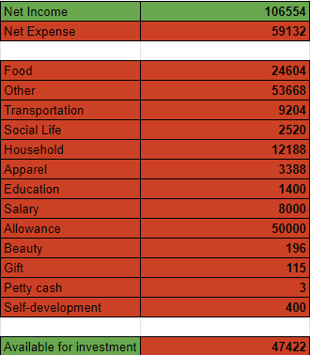
Filling in the Numbers

Slide 8
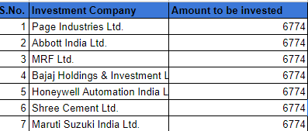
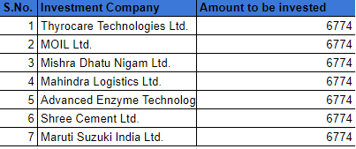
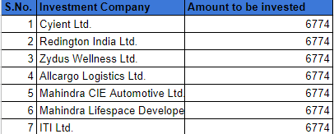
Filling In the list of stocks
Low Risk Taking
High Risk Taking
Moderate Risk Taking

Slide 9
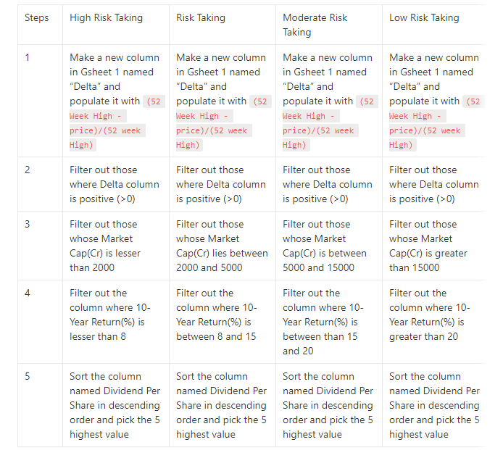
CRITERIA to select list of stocks given the risk appetite

Slide 10
Project Findings

Slide 11
In 3 Years time span, greatest volatility was seen in case of Technology industry and least volatility in Consumer Staples industry.
In 5 Years of time span, greatest volatility was seen in Diversified sector and least volatility in Others and Insurance Sector.
The industries like Insurance and Others see a change in stock prices only in 3 years of time span while in 5 years of time span, there is no change in highest and lowest values of the stocks.
This implies that the stability of investment in stocks vary depending on the industry and the time span.
Mostly, the industries that are more stable in 3 Years time span are volatile in 5 Years time span.

Slide 12
Returns from Stocks across different time spans
Overall it was seen that the sectors were offering higher returns in a period of 3 Years with Chemical sector giving the highest return of about 1524.19 and Finance sector giving a return of 20.53.
Also, it was seen that in terms of returns received in 3 Years, no industry had any negative return.
While in case of 1 Year returns, Consumer Discretionary, Healthcare, Insurance and Technology have negative returns.
Overall, Insurance sector was seen to perform the worst in case of returns.

Slide 13
Industry Names | Negative Returns | Positive Returns
Drugs & Pharma | 5 | 31
Software |  | 24
Banking | 10 | 15
Cement | 1 | 13
Real Estate |  | 12
Organic Chemicals |  | 10
Misc. Fin.services | 5 | 9
Auto Ancillaries | 1 | 9
Electricity Generation |  | 7
Household & Personal Products | 1 | 7
Kitchenware & Appliances |  | 6
Natural Gas Utilities | 1 | 6
Housing Finance | 2 | 5
Construction | 2 | 5
ACs & Refrigerators | 2 | 4
Negative Returns vs Positive Returns across all the Industries
Drugs and Pharma industry has the greatest number of giving positive returns but it also has stocks that offer negative returns.
Software industry on the other hand has stocks that only have the positive returns.
In Banking industry, there are the largest number of stocks that deliver negative returns.
Thus, in this regard, Software industry can be considered as the best option.

Slide 14
Share of Market Capitalisation Across Different Industries
Largest share of market capital is held by the financial Industry followed by Energy industry.
Least amount of market share is held by industries like Textiles and Diversified.
This pie also reflects a significant differences in the market share across different industries.

Slide 15
Median Enterprise Value across Each Sector
Insurance, Energy, Communication, Automobile, Financial and Diversified sectors have better enterprise values among all the sectors.
Insurance sector holds the maximum enterprise value of approximately 74000(CR) followed by Energy sector that holds the 64000(CR).
Service sector holds a minimum value of approximately 9600(CR) preceded by Construction sector holding approximately 10000(CR) value.

Slide 16
Stock Prices Across Industries
The highest range of stock prices is observed in the automobile industry while it is lowest for the Others industry.
Average price of stocks is highest in the Textiles industry while lowest in Communication industry.
However, the gap between the price range and the average price is in the Diversified sector, which implies that the price stock remains in the same price range and the stocks are priced approximately around 7000.
Meanwhile this gap between the price range and average price is minimum for Healthcare Industries.

Slide 17
Relationship Between Dividend Per Share and Market Capital
Correlation between Dividend Per Share and Market Capital = 0.041
R² = 0.0195
This signifies a weak relation between dividend per share and market capital.

Slide 18
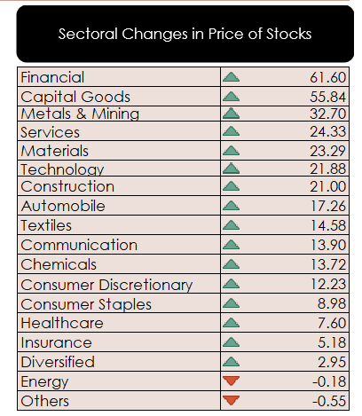
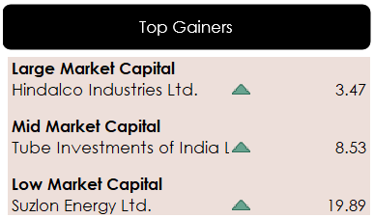
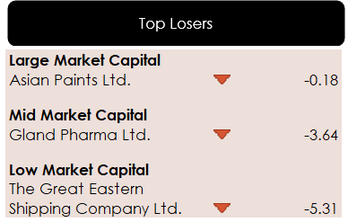
Other Findings From the Dataset

Slide 19
Project Insights

Slide 20
CHOICE OF KPI
KPI that was picked to analyze every stock was EV/EBITDA.
This KPI was chosen to also consider the company’s operating performance since we picked from a mix of the large-mid-low level of market capital stocks.
An interesting fact was that the stocks shortlisted in this criteria also performed well in the market overall judging by their performance in other parameters.
The criteria to assort the set of stocks was made based on the following parameters:
Price to Earning to Growth Ratio
(Lower than 1)
Earning Per Share
(80 or higher)
Price to Sales Ratio
Price to Cash Flow Ratio
(Below 15)
EV/EBITDA
(Below 10)
P/B Ratio
(Between 1-3)
Dividend
Payout Ratio
(Between 30-50%)
Dividend Yield
(Between 2-6%)

Slide 21


